Slide 1
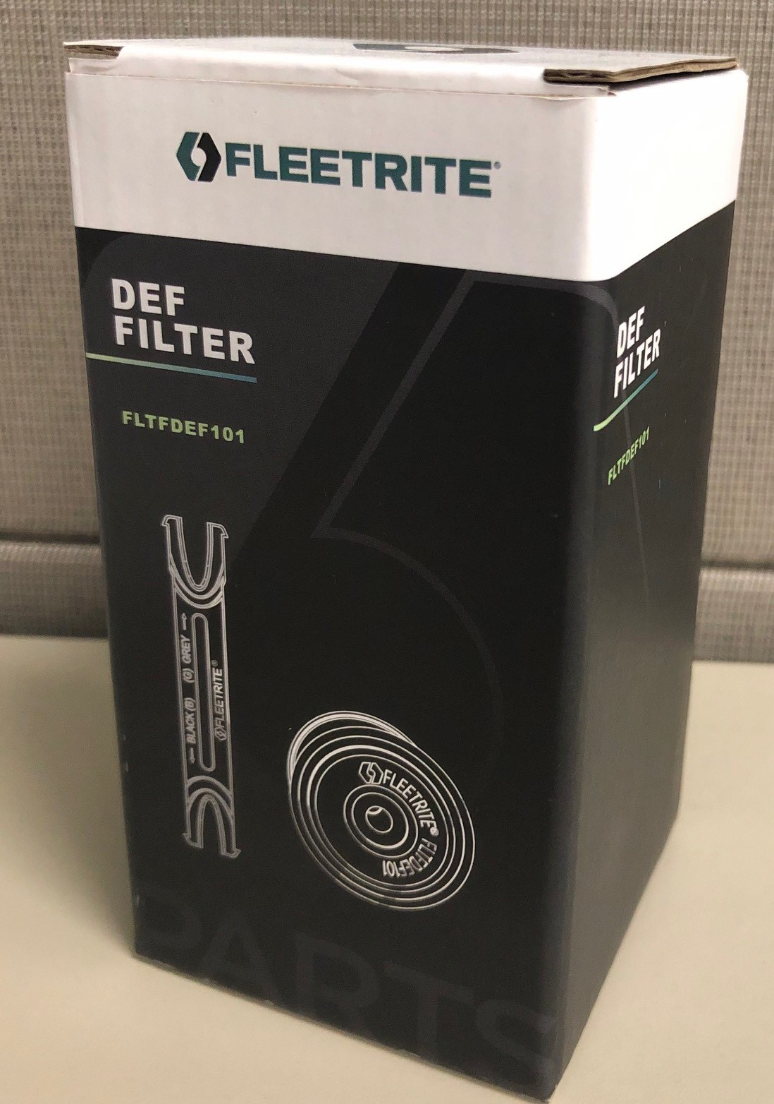
Updates to Packaging Specifications
Please be advised that packaging specification documentation for Fleetrite and RENEWED have been updated to the 2018 standards.

